Slide 1
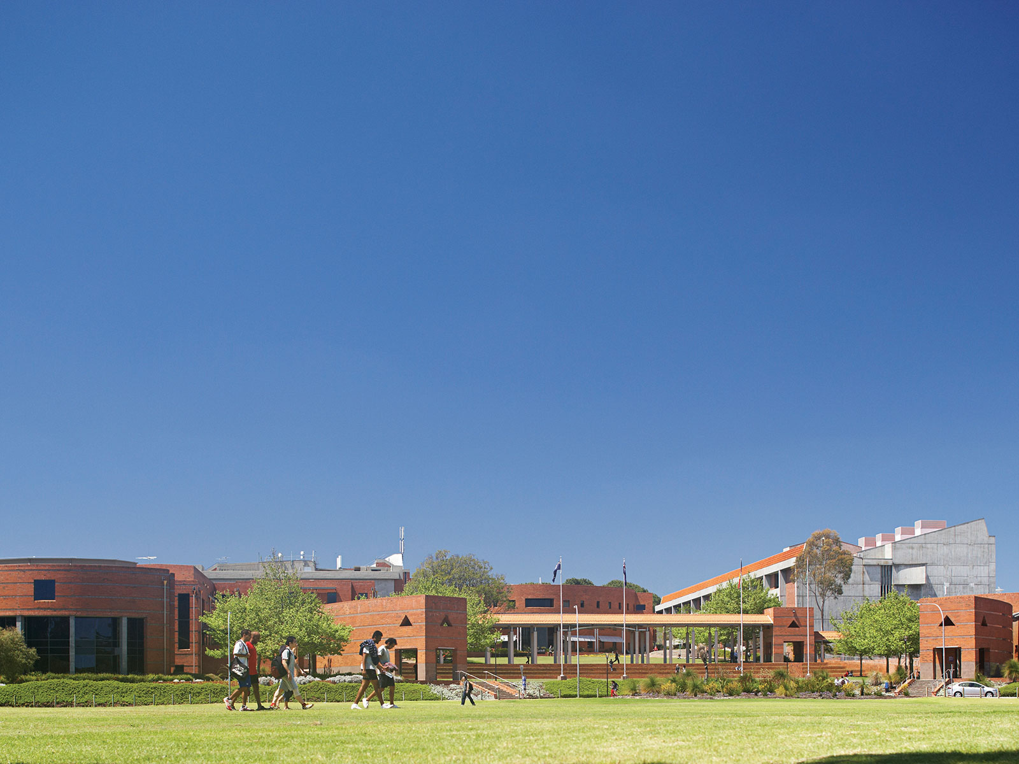
Why do Whales Beach Themselves? Using web 2.0 tools to teach science inquiry from the primary classroom to the tertiary lecture room
IAFOR 2015, Brighton UK 1st -5th July 2015
Dr Rachel Sheffield, Leonie McIlvenny, Geoff Quinton

Slide 2
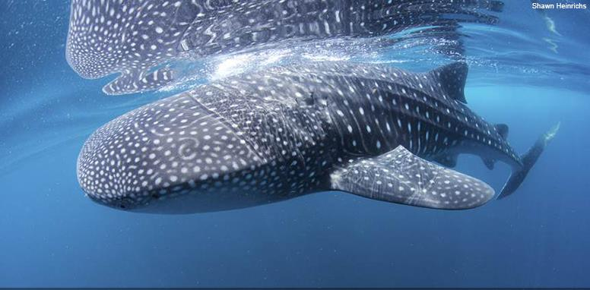
Notes:
Objective
Improve confidence in science
Increase science knowledge

Slide 3
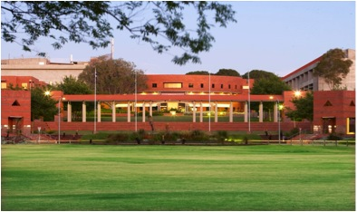
New course – Bachelor or Education
Science unit – pre-service

Slide 4
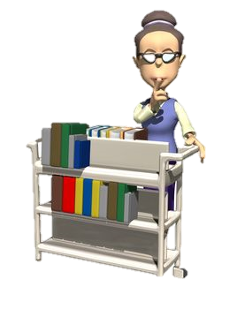
Teacher Librarian
Technology Geek
Science Nerd
Year 7 students in 1st year high school
Tertiary
Pre-service
1st years in Primary/EC
Science Extension in Primary Year 5-7
Notes:
Key focus questions
1) Who
2) What
3) Where
4) When
5) Why
6) How

Slide 5
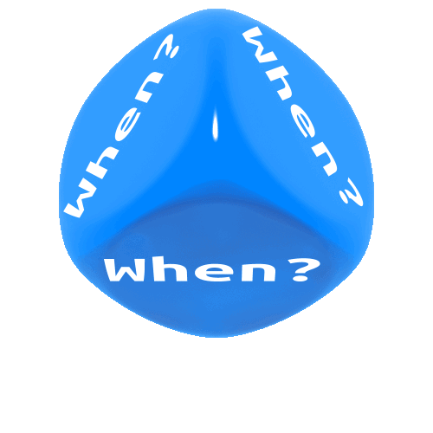
Tertiary Cohort
Stage 1 2013, Semester 2 Internal and Regional
Stage 2 2014, Study Period 2 OUA
Semester 2 Internal and Regional
Stage 3 2014, SP 4 OUA
2015, SP2 OUA
2015, Semester 2

Slide 6
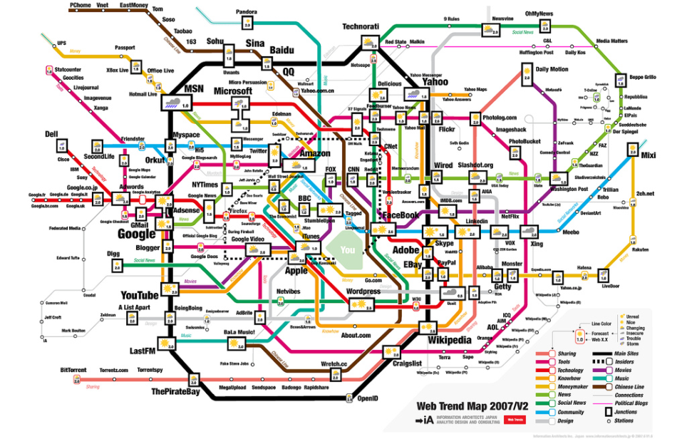
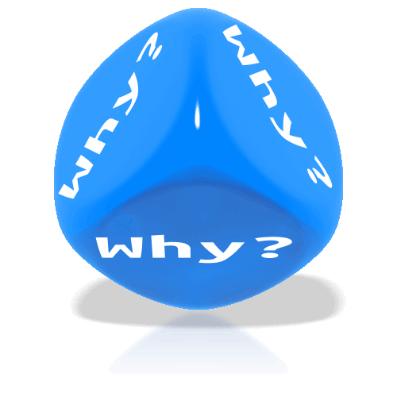

Slide 7
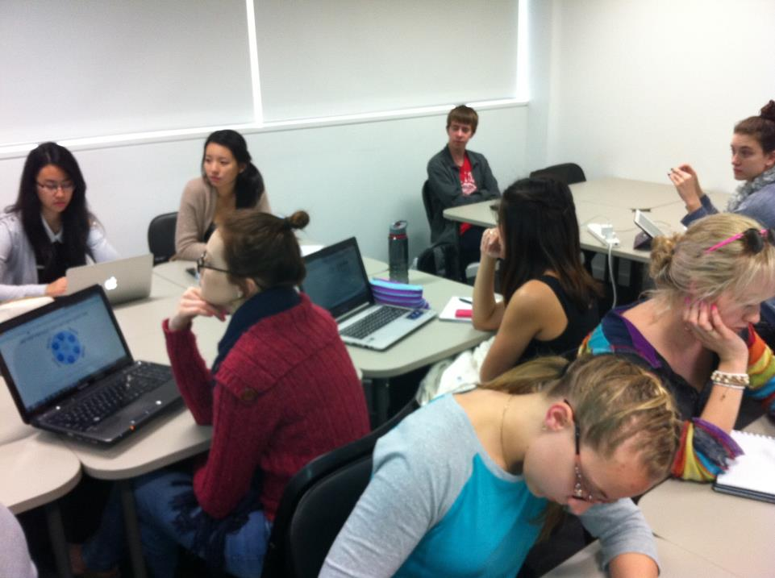
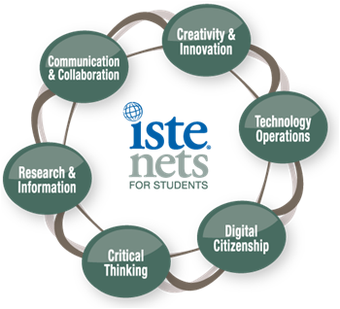
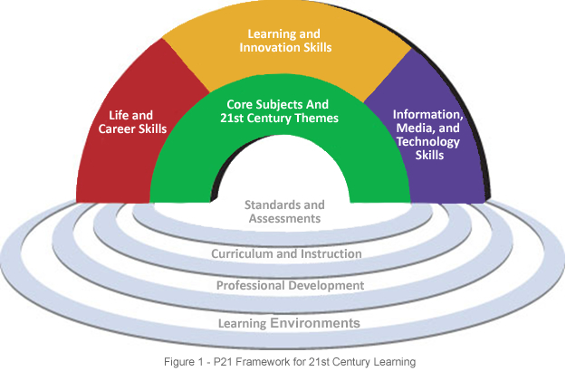
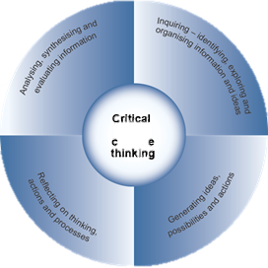
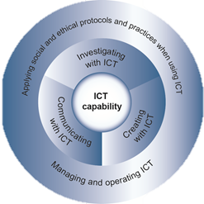
Why do students/pre-service teachers need 21 Century Skills and Strategies in Science Space?
Notes:
Key Drivers for Change
Internationally
UNESCO
ISTE
21 Century Learning skills
National Drivers
Melbourne Declaration of Educational Goals for young Australians
Australian Curriculum
AITSL Standards (Teachers Standards)
Local
University compliance
TTF Project – Teaching Teachers for the Future Project
New Bachelor of Education Course
Open University OUA Course

Slide 8
Intersection of ICT, Inquiry and Web 2 Tools
Science
Sustainability
Technological,
Pedagogical
Science Content
Knowledge TPASK
Inquiry
Information Literacy
Science Data & Knowledge
Pedagogy
Technology
Web 2.0 tools

Slide 9
Science Content

Slide 10
Notes:
Web platform
Model web 2 tools
Authentic investigative skills task
Incorporate elements from the AC Sustainability
Collaborative teaching
Challenge how technologies were used in the classroom (BYOTT)
Flipped classroom approach
Model new pedagogies
Transition to face to face to fully on line
Authentic classroom
Transferable skills - teaching skills, research skills

Slide 11
Information Processing Matrix
Pedagogy
Science Inquiry Skills | Information Process
Questioning and predicting | DEFINING
Planning and conducting | DEFINING LOCATING SELECTING
Processing and analysing data and information | PROCESSING ORGANISING SYNTHESISING
Evaluating | EVALUATING
Communicating | PRESENTING
Notes:
Questioning and predicting: Identifying and constructing questions, proposing hypotheses and suggesting possible outcomes.
Planning and conducting: Making decisions regarding how to investigate or solve a problem and carrying out an investigation, including the collection of data.
Processing and analysing data and information: Representing data in meaningful and useful ways; identifying trends, patterns and relationships in data, and using this evidence to justify conclusions.
Evaluating: Considering the quality of available evidence and the merit or significance of a claim, proposition or conclusion with reference to that evidence.
Communicating: Conveying information or ideas to others through appropriate representations, text types and modes.

Slide 12
Key Design Features
Authentic and open-ended – topics based on real-world, authentic environmental projects around sustainability.
Accessibility – Materials collated on a companion website all students, to access all the learning tasks/learning activities (i.e. voki ) http://inquiringabouttheworld.weebly.com/.
Notes:
Key Pedagogical Features
The unit considered key pedagogies during the design process. These were
Inquiry – the unit utilised the inquiry strand of the Australian Science Curriculum enabling students to actually engage in an inquiry task.
Authentic and open-ended – the topic that the students’ chose were based on real-world and authentic environmental projects around sustainability that students found on-line, in newspapers, TV news articles or were something they had seen in their world. Sustainability is a key cross curriculum priority in the Australian Science Curriculum
Technology based- web 2.0 tools were embedded in the topic in an authentic way. Students were required to select tools when they were considered to be the most effective method to collect, collate or present information. Reflection at the conclusion of the topic enabled them to consider if and when they could use these tools in their primary or early childhood classrooms.
Accessibility – Materials were collated on a companion website and this enabled all students, those fully on-line and those who were working internally, to access all the learning tasks/learning activities and links to other necessary materials (i.e. voki ) http://inquiringabouttheworld.weebly.com/.
Scaffolded learning and assessment – The tasks were broken down into smaller more manageable steps that the students could complete one at a time. The unit included both formative and summative assessment types with tutors providing detailed feedback on the formative assessment to enable students to refine their work to produce their final summative assessment. In this way students saw the tutors working with them to a common end which was to produce a final project.
Collaboration – the unit was designed to foster multiple forms of collaboration.
A team of two tutors worked in tandem in a single classroom.
Students were able to communicate on Discussion Board Padlet which is an anonymous discussion board and Collaborize which is another closed discussion platform students can use.
Students were also able to work collaboratively on part of the tasks, however, University assessment policy precluded them from completing a complete collaborative project together as policy stipulates that only 50% of a unit assessment can be completed collaboratively. Consequently they were only able to present their findings in Assessment 3 together.
Critiquing and feedback were used throughout the project in the weeks before an assessment item was due. Students were required to listen to their peers in groups and respond with thoughtful probing and clarifying questions and feedback. Instructions were also provided on the website and regional students were allocated groups on the University BB site to enable them to work together.
Open-ended and differentiated – the task was open-ended and could be examined at different depths depending on the students’ ability. Students examined a range of ideas such as the complex ‘Examining the Changing Biodiversity within Afghanistan as a result of the War’ to a more simplistic examination of the reasons why there were less polar bears in the world.
Engaging – as students were able to choose their topic to ensure it was a topic that interested and engage them for the total course of the semester.
Flipped class approach – tutors often spent a short amount of time discussing the learning activities for the day but the majority of the internal workshops were spent helping students individually to complete the learning activities which would then enable them to complete their move forward on their Inquiry Journey to complete their project.

Slide 13
Scaffolded learning and assessment –formative and summative assessment types
Collaboration –
A team of two tutors in a single classroom.
Communicate on Discussion Board ,Padlet and Collaborize
Work collaboratively on part of the tasks
Differentiated – the task was open-ended and examined at different depths
Flipped class approach – coaching
Modelled – modelled process and tools for industry
Contextual application - of tools
Notes:
Scaffolded learning and assessment – The tasks were broken down into smaller more manageable steps that the students could complete one at a time. The unit included both formative and summative assessment types with tutors providing detailed feedback on the formative assessment to enable students to refine their work to produce their final summative assessment. In this way students saw the tutors working with them to a common end which was to produce a final project.
Collaboration – the unit was designed to foster multiple forms of collaboration.
A team of two tutors worked in tandem in a single classroom.
Students were able to communicate on Discussion Board Padlet which is an anonymous discussion board and Collaborize which is another closed discussion platform students can use.
Students were also able to work collaboratively on part of the tasks, however, University assessment policy precluded them from completing a complete collaborative project together as policy stipulates that only 50% of a unit assessment can be completed collaboratively. Consequently they were only able to present their findings in Assessment 3 together.
Critiquing and feedback were used throughout the project in the weeks before an assessment item was due. Students were required to listen to their peers in groups and respond with thoughtful probing and clarifying questions and feedback. Instructions were also provided on the website and regional students were allocated groups on the University BB site to enable them to work together.
Open-ended and differentiated – the task was open-ended and could be examined at different depths depending on the students’ ability. Students examined a range of ideas such as the complex ‘Examining the Changing Biodiversity within Afghanistan as a result of the War’ to a more simplistic examination of the reasons why there were less polar bears in the world.
Engaging – as students were able to choose their topic to ensure it was a topic that interested and engage them for the total course of the semester.
Flipped class approach – tutors often spent a short amount of time discussing the learning activities for the day but the majority of the internal workshops were spent helping students individually to complete the learning activities which would then enable them to complete their move forward on their Inquiry Journey to complete their project.

Slide 14
Technology

Slide 15
Unit Learning Outcomes:
1. Develop lifelong learning skills including: analytical thinking, information management; technology skills and communication skills
2. Apply processes of inquiry to carry out a scientific investigation
3. Report on the outcomes of the processes of inquiry using a range of Information and Communication Technologies
4. Evaluate the outcomes of the inquiry processes in the context of the science and humanities content from the Australian Curriculum
Notes:
Objective
Improve confidence in science
Increase science knowledge

Slide 16
Assessment Tasks:
Project Plan 15 % Week: 3
Project Report A 20 % Week: 7
Project Report B 45 % Week: 12
Exhibition of Project 20 % Week: 13

Slide 17
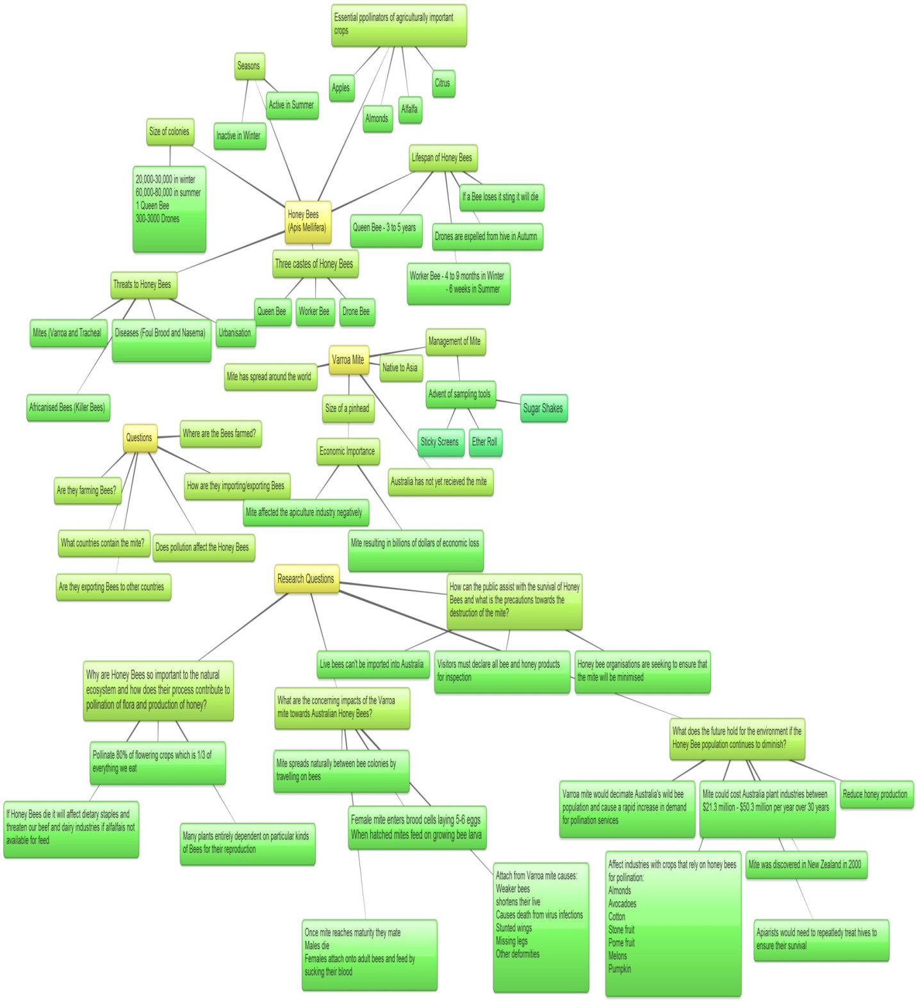
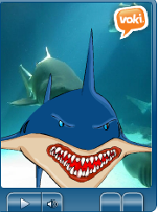
Science Inquiry: Planning and conducting Information Process : Defining, Locating, Selecting

Slide 18
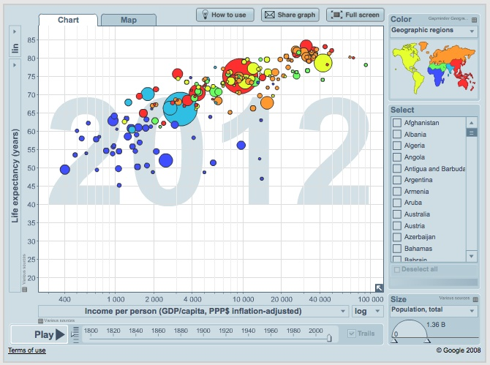
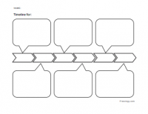
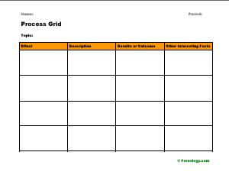
Science Inquiry: Processing and analysing data and information Information process stage: Processing, organising and synthesising
Content curation tools
Graphic Organisers
Gapminder

Slide 20
Science Inquiry: Evaluating Information Process Stage: Evaluating
Rubrics
Audacity
Survey Monkey
Critique (Peer evaluation) formative evaluation

Slide 21
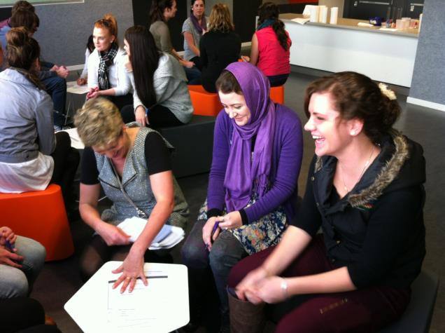
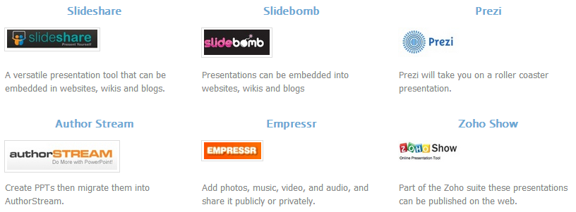
Science Inquiry: Presenting Information Process Stage: Presenting
Assessments
Final presentation showcase
Final report

Slide 23
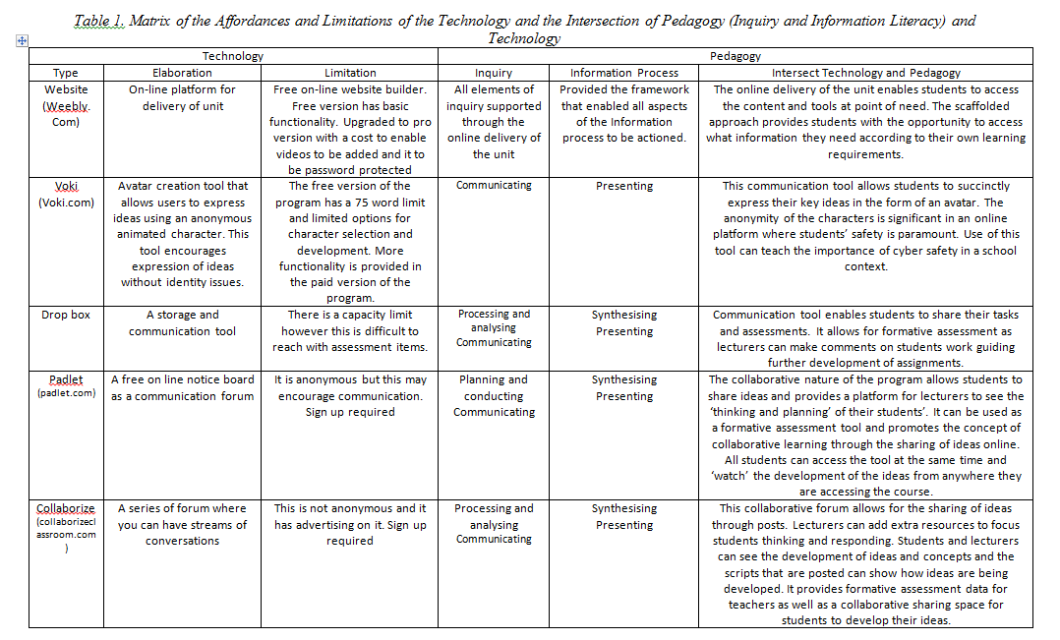

Slide 24
So what?
Measuring success…………………..
Student surveys
Student comments
Transferability
Year 7 Secondary school
Year 5,6 Primary school

Slide 25
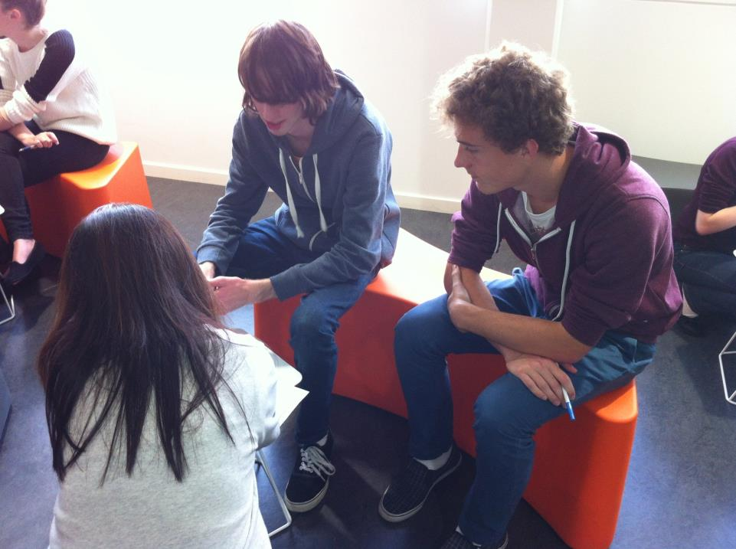
Quote: This unit endeavours to challenge our views on controversial topics and question evidence that we've presented. It helps us develop personal positions and opinions. It's fantastic.
94 % improvement in student confidence using web 2.0 tools
Was it Successful ?
90% of students said that it had improved their understanding of Science concepts and science inquiry
Quote: I enjoy this class a lot as I find it fun, interesting and challenges our views. I like the method of teaching as they are personal and inviting. I like how they go around the room one on one, have group work and talk in front of the class. Favourite class of the week!

Slide 26
This unit makes me think, it makes me ask questions that make me ask more questions. The website is a clear step by step journey so I always know where I am and where I am heading. The classroom is well set up allowing small group interaction while encouraging whole class presentations and discussions. Having three screens to view ensures everyone can easily see and interact with the learning material. ……. I love the challenges this unit present and the drive it evokes within me.

Slide 29
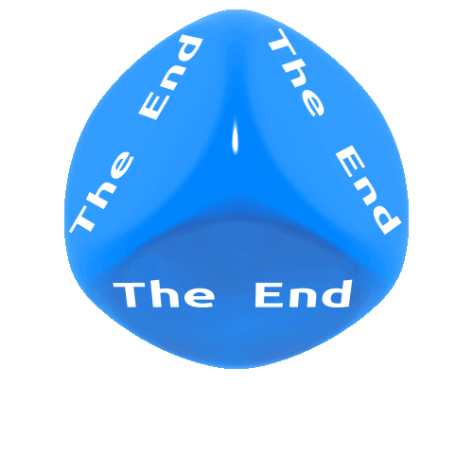
www.inquiringabouttheworld.weebly.com
Rachel.Sheffield@curtin.edu.au
lmcilvenny@iona.wa.edu.au
@ScienceEdCurtin
Notes:
Objective
Improve confidence in science
Increase science knowledge

Slide 30
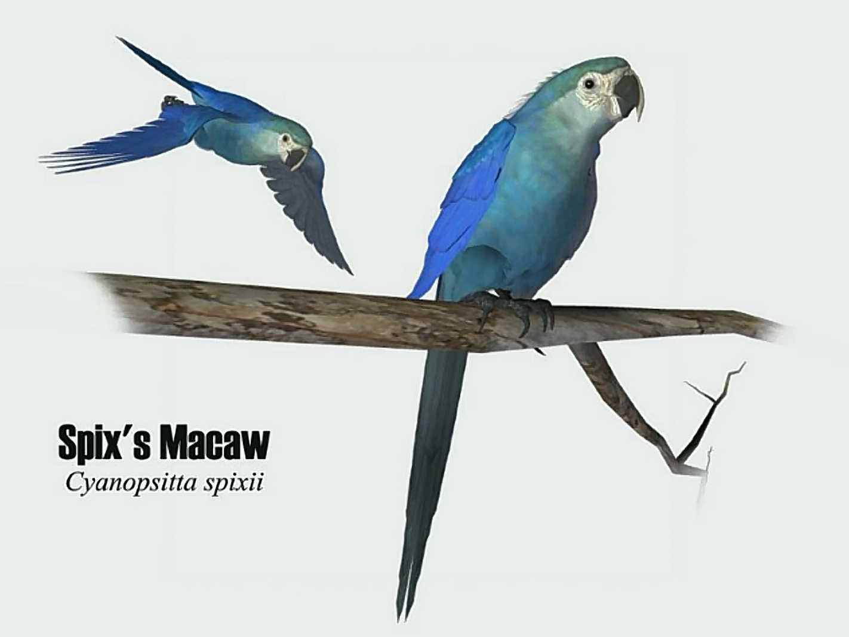
Presentation

